Slide 1
Parking Slot

Slide 2
Background and Motivation
We have all been in a huge parking lot before and not been able to find a parking spot
Imagine being late for a flight and upon entering the huge parking lot, a simple display tells you exactly how to get to a great parking spot
Minimize road rage incidents resulting from people stealing spots

Slide 3
Overview of System
User will be able to drive up to parking lot and view current map of parking spots
User can then determine the optimal spot and reserve the spot using the GUI.
The spot will remain reserved until they take the spot or their time expires.

Slide 4
Operation of System
Have camera(s) mounted somewhere to view all of the spots
Image Processing to determine spot locations
Snapshot every few seconds
Have some way of determining spots
  -Have reference image to compare current image to
  -Compare image I to image I-1, look for noticeable differences
    Subtle differences (between spans of seconds) can be caused by ambient conditions, shadows, etc

Slide 5
Parts
Video Camera
  Webcam, wireless
Interaction with user
  Output: Display – to show user available spots
  Input: Keypad, some way for user to choose spot

Slide 6
Things to Consider
How many cameras?
  More cameras will yield a greater accuracy on which spots are open and which are not
    Unknown factors may block a camera such as a large truck blocking one camera entirely
Angle of cameras to cars
  facing parallel or perpendicular to sun’s path
  Glare of sun will be a factor
  Should be positioned parallel to the cars
Image Processing
  When should the comparative snapshot be updated?

Slide 7
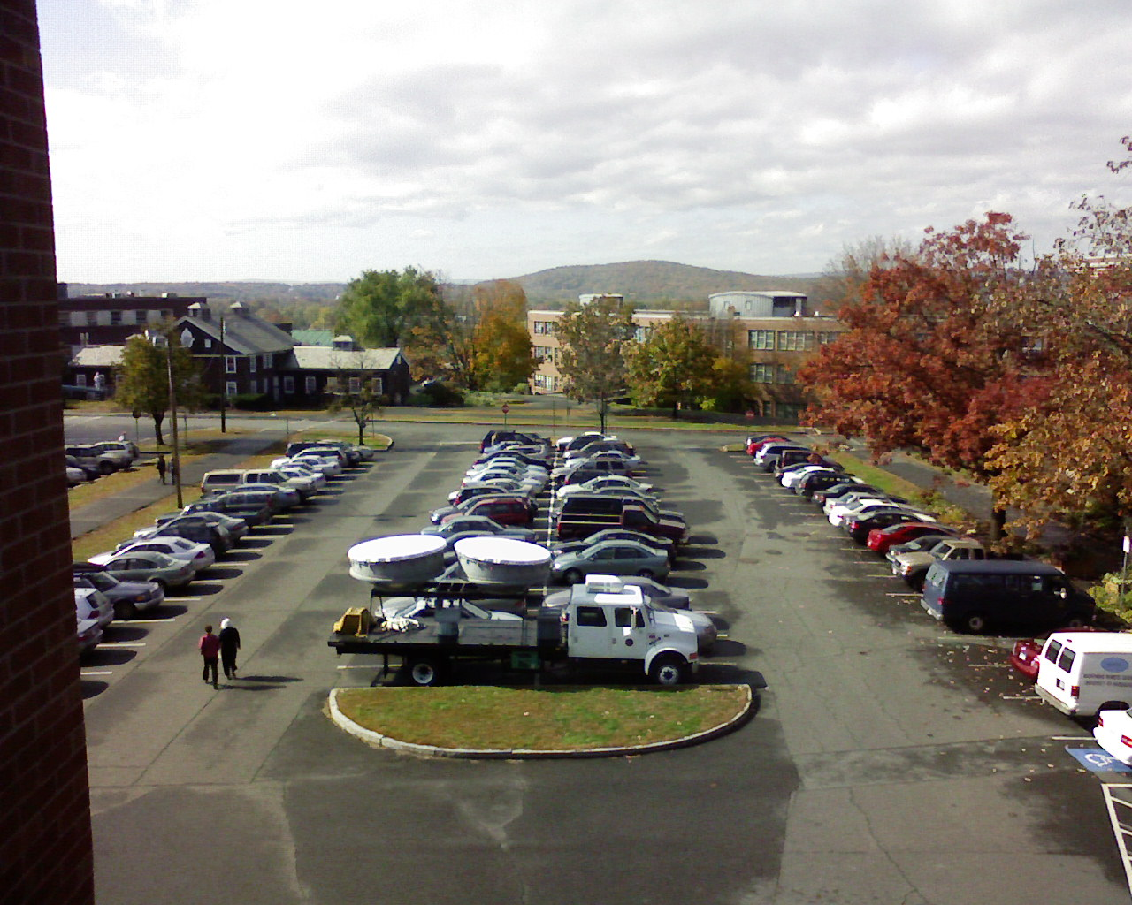
Example
Problems with this picture?

Slide 8
Image Processing
Logitech web cameras have API available
  Possibly develop our own image processing tool
Import frame from camera, import into MATLAB or similar tool for processing
Take comparative snapshot array and subtract it from base snapshot array to see differences

Slide 9
Testing Our System
Get the camera(s) mounted within the month
  Start capturing pictures and getting the picture array data into a usable form.
  Start using real world testing.

Slide 10
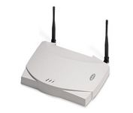
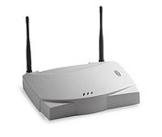
Block Diagram
Base Station
Video Camera
Request Image
Take Picture
Receive Image
Transmit Image
Image Processing
Laptop
Mapping Algorithm
GUI

Slide 11
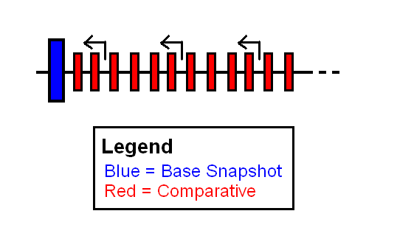
Alternative Methods
Advantages and Disadvantages?

Slide 12
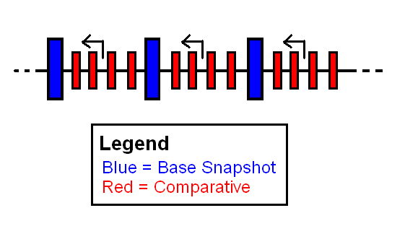
Alternative Methods
Advantages and Disadvantages?

Slide 13
Deliverables
Camera mounted above a parking lot
Image gets sent to base station, which is able to accurately map out the parking spots
Have user drive up to parking lot and select a vacant spot
System reserves spot for user, updates map when user parked

Slide 14
Proposed MDR Specifications
Camera(s) mounted in optimal location
Camera able to transmit image to base station, base station able to receive image
Basic image processing on image

